Slide 1

Birmingham : Part-by-part overview
Bram Van Cauwenberghe
26.03.2021
Notes:
(photo is of a tensile test at Industeel, Le Creusot, France)
Good afternoon and good morning everyone and welcome to the Q1 results presentation.
Today I am joined by…

Slide 2
B’ham orderbook – UWBs die cut
Customer | T-Reference | Steel grade | Thickness | Coil width (ccalc) | Parts/stroke | Side evacuation
Tallent Automotive Limited | T-GES6003BLK-Z | BH260+Z | 1,5 | 1105 | 2 | YES (LEFT)
JAGUAR LAND ROVER LIMITED | T-JLR6120V2BLK-Z | BH220+Z100 MBO | 0,8 | 1774 | 1 | NO
JAGUAR LAND ROVER LIMITED | T-JLR6253V2BLK-Z | DP450+Z100 | 1,6 | 1710 | 1 | NO
JAGUAR LAND ROVER LIMITED | T-JLR6266V!BLK-Z | BH180+Z100 | 1 | 967 | 1 | NO
Liberty Pressing Solutions (Coventry) | T-LIB6001BLK-Z | DC06 | 1,2 | 1480 | 1 | NO
SNOP | T-NIS6114V1BLK-Z | XE360B | 1 | 904 | 1 | NO
SNOP | T-NIS6115V1BLK-Z | XE360B | 1 | 904 | 1 | NO
SNOP | T-NIS6118/9V1BLK-Z | XE360B | 1 | 1029 | 1 | NO
SNOP | T-NIS6120/1V1BLK-Z | XE360B | 1,2 | 947 | 1 | NO
SNOP | T-NIS6122/3V1BLK-Z | XE360B | 1,6 | 995 | 2 | YES (RIGHT)
SNOP | T-NIS6124/5V1BLK-Z | XE360B | 1,6 | 1311 | 2 | YES (RIGHT)
New Nissan Qashqai business will represent +/- 70% of UWB die cut orderbook in 2022

Slide 3
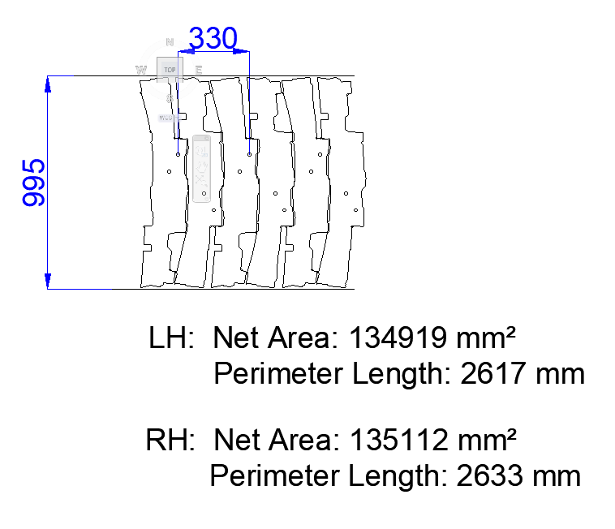
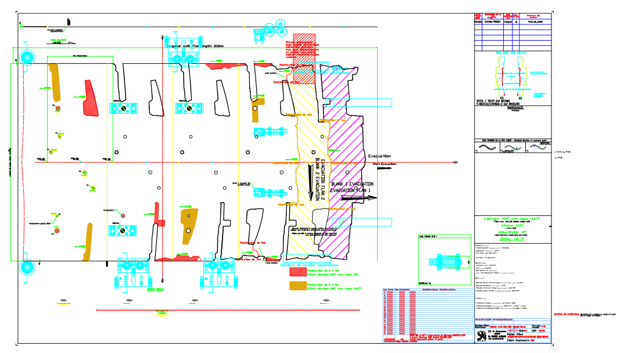

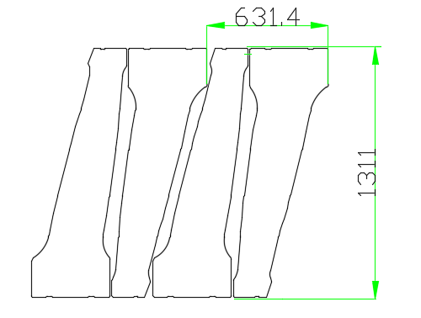
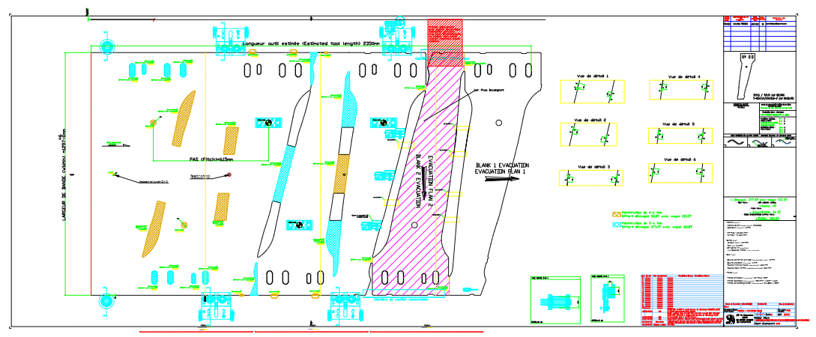
B’ham orderbook – UWBs die cut – new Nissan Qashqai UWBs
T-NIS6122/23
→ Evacuation to the right side : LIEGE
Liège considered as contingency press.
T-NIS6124/25
→ Evacuation to the right side : LIEGE
Liège considered as contingency press.

Slide 4
B’ham orderbook – UWBs die cut
T-GES6003
→ Evacuation to the left side : LIEGE
Die compatibility to be checked & confirmed by Tooling Team.

